Slide 1


GDPR Workshop

Slide 2
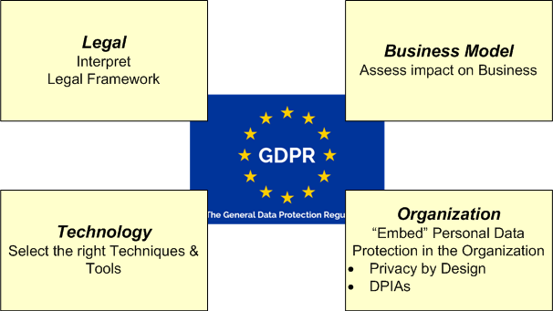
GDPR – Compliance / Business / Technological requirements

Slide 3
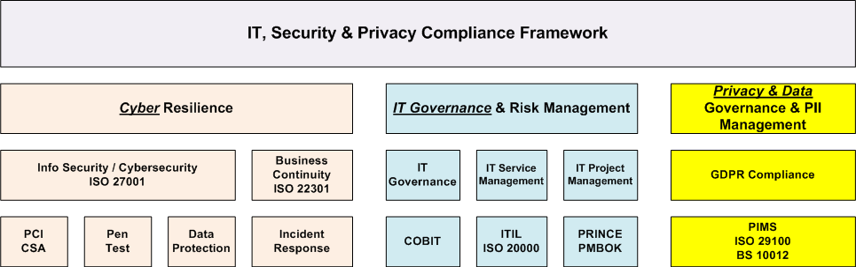
Privacy Management / PII Protection within a total
IT / Security / Privacy Framework

Slide 4
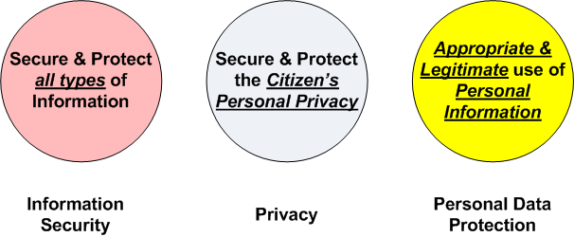
Info Security vs. Privacy vs. PII Protection: Different Perspectives
Security by Obscurity…..
…….Privacy by Transparency

Slide 5
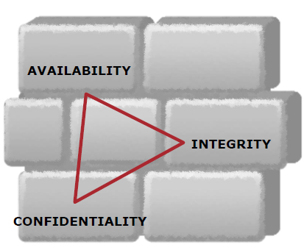
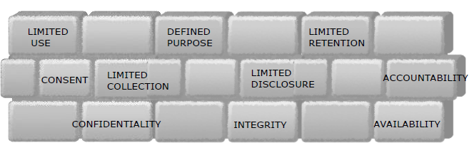
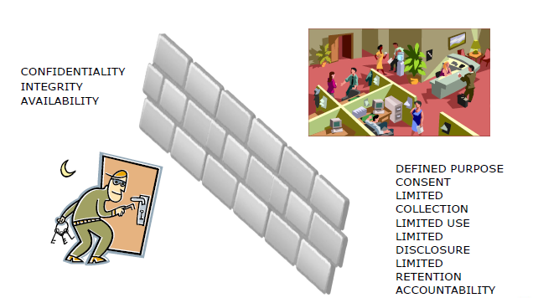
Privacy / PII Governance: Security vs. Privacy
Security
Privacy

Slide 6
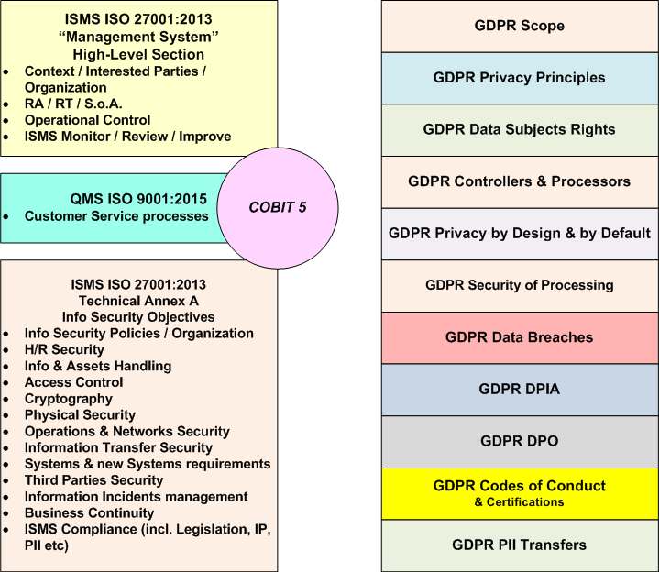
“Mapping” GDPR requirements inside ISO 27001:2013

Slide 7
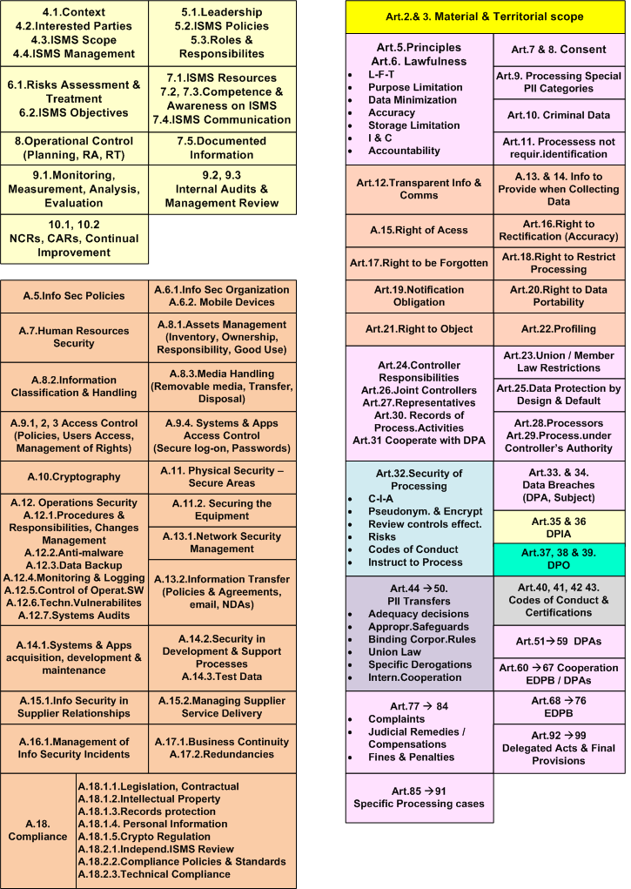
ISO 27001
GDPR

Slide 8
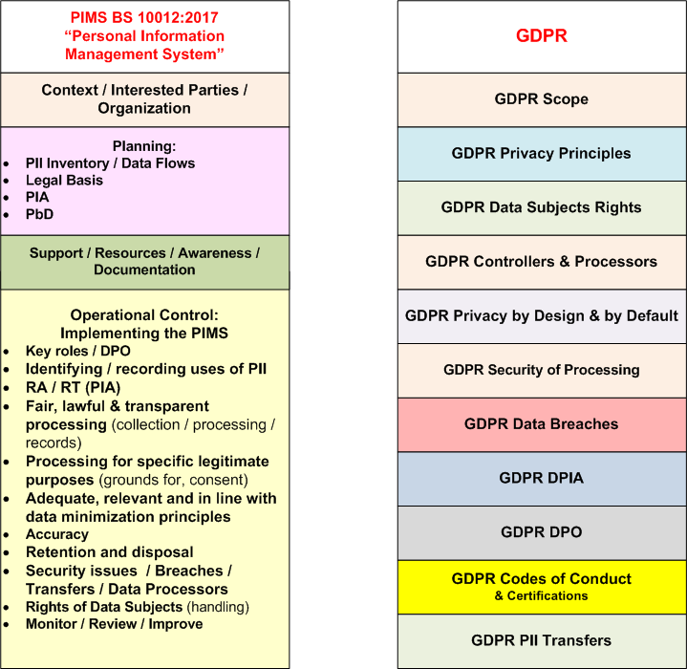
“Mapping” GDPR requirements inside BS 10012:2017

Slide 9
Privacy & Information Security: the basic Standards Ecosystem
Framework - Overall Management System Level
ISO/IEC 27001:2013
(Requirements for ISMS)
ISO/IEC 29100:2011
(Privacy Framework)
*PCI DSS
(v. 3.2)
* CSA & other
Cloud schemes
PIMS
BS 10012:2017
Risk Management Level
ISO/IEC 27005:2011
Risk Management
NIST SP.800-30
ISO/IEC 29134:2017
(Guide for Privacy Impact Assessment)
ISO/IEC 27002:2013
(Code of Practice for ISMS)
ISO/IEC 27017:2015
(Code of practice for Cloud Services)
NIST Codes of Practice
(NIST SP.800-53)
ISO/IEC 29151:2017
Code of practice for PII protection
ISO 27799:2016
Health Data
Controls
Level
ISO/IEC 27018:2014
Code of Practice for PII protection in public clouds acting as PII processors

Slide 10
Personal Data Discovery / Mapping / Classification
Data Discovery Techniques comparison
Technique | “Known” Data | “Unknown” Data / Unstructured Data | Purpose of Processing & Data Flows | IT Expertise needed
Questionnaires | ☑☑ |  | ☑
Interviews | ☑☑ | ☑☑ | ☑☑
Automated Scanning Tools | ☑☑ | ☑ |  | ☑
“Combined” Techniques (use of APIs) | ☑☑☑ | ☑☑☑ | ☑☑ | ☑☑

Slide 11
Personal Data Discovery / Inventory / Mapping: Techniques & Tools
 | Tool | Use | typical Vendors
“Manual” Techniques | Database & File Server “manual audit” | PII Discovery
 | Database “scripting” | PII Discovery
 | Excel or “simple” Databases | PII Inventory & Mapping | Microsoft
 | Technical Flow Charters | PII Flow & Mapping | MS Visio & “similar” flowcharters
(semi) Manual | BPM suites | PII Mapping / Modelling | ARIS & other BPM suites
Automated Tools | Fileshare / Crawlers | PII Discovery | CASAHL
 | Data Classification / Protection Tools | PII Discovery & Classification | *TITUS *Spirion / *Varonis
 | Data Discovery / Mapping / Management Platforms & Visual Mappers | PII Discovery & Mapping | *One Trust *AvePoint *Altova MapForce
 | GDPR-focused data inventory / mapping tools | PII Inventory / Mapping | *Trust Arc suite *Nymity (Expert Mapping tool)
 | Integrated Database Security / Discovery suites | PII Database Security / Data Discovery & Mapping | *IBM Infosphere / Guardium *Imperva
 | Data Loss Prevention (DLP) | PII Discovery / Protection | (many Vendors)

Slide 12
GDPR: the Legal & Compliance “ecosystem”
“The Police Directive”
2016/680/EU *
→ 6.5.2018
(replaces 2008/977/JHA)
“ePD” Directive
2002/58/EC ***
Originally amended by 2009/136/EC
*under reform (2018)
“GDPR” Regulation 2016/679/EU
→ 25.5.2018
(replaces EC/95/46)
“PNR” Directive
2016/681/EU **
24.5.2018
(replaces 2004/82/EC)
“eCD” Directive 2000/31/EC
(eCommerce Directive)
“NIS” Directive
2016/1148/EU *****
→ May 2018
“eIDAS” Regulation
910/2014/EU ****
1/7/16 → Sep.2018
(replaces 1999/93/EC
* “The Police Directive” (Police & Criminal Justice) - repealing Council Framework Decision 2008/977/JHA)
**** eIDAS = Regulation for eID & Trust Services for electronic transactions
** PNR = “Passenger Name Record” Directive
***** NIS = “CyberSecurity” Directive on Networks & IT Systems Security
*** ePD = Directive on Privacy and Electronic communications (incl. cookies)

Slide 13
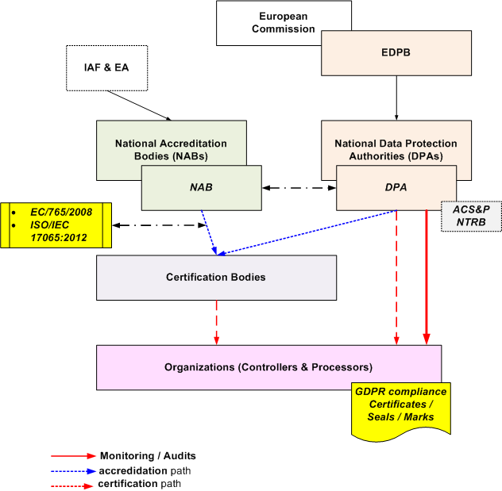
GDPR Certification scheme (Art. 42-43)
Article 29 WP261
“Guidelines on Accreditation of Certification Bodies”
6.2.2018

Slide 14
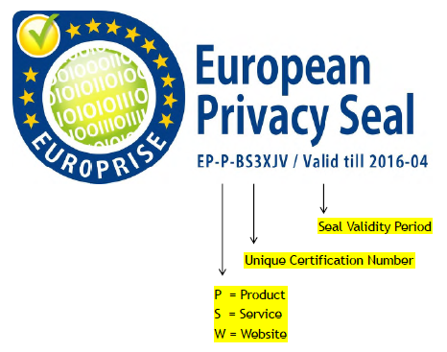

GDPR: Seals & Marks / Codes of Conduct
IT Products & IT-related Services Certification:
ref. EuroPrise “Privacy Seal” - certification criteria & certified products / services / web sites list
the new GDPR-ready criteria for the European Privacy Seal is operational as of January 2017
ref. CISPE.cloud (Cloud Infrastructure Services Providers – Code of Conduct)

Slide 15
Data Protection Officer (DPO)
DPO Training & Personal Certification
(Personnel Certification schemes)
ref. GPDR – Art. 37 - 39
ref. 16/EN WP 243 (13.12.2016) “Guidelines for Data Protection Officers (DPOs)” & related FAQs
http://ec.europa.eu/justice/data-protection/index_en.htm
Designation of the DPO
Position of the DPO
Tasks of the DPO
Spanish DPA (AEPD)
DPO scheme (2017)
“Person Certification” for DPOs
(ISO/IEC 17024 scheme)
DPOs Training
(DPO Professional Seminars)

Slide 16

DPO: Climbing the “Ladder of Skills”
Managerial / Business Skills
Legal
Background / Skills
Info Security Background / Skills

Slide 17



DPO: Training issues
Personal Data
GDPR
Legislative context
Compliance
Data Privacy
Data Management
Audit Skills
“Technical” Skills
A “single” seminar or “split” / specialized seminars ?
Minimum training duration ?
iapp / Certified Information Privacy Professional/Europe (CIPP/E)
& Privacy Manager (CIPM)
iapp / Certified Information Privacy Technologist

