Slide 1
GDPR - New Data Protection Regulation
When is Data protection impact assessment mandatory?
Delia Străchinescu, Legal Division
UniCredit Bank S.A. Public information
Bucharest, 21st of March 2018

Slide 2

What is a Data Privacy Impact Assessment (DPIA/PIA)?
Also known as privacy impact assessment or PIA, it is a tool which can help organisations identify the most effective way to comply with their data protection obligations and meet individuals’ expectations of privacy.
Particularly relevant when a new data processing process, system or technology is being introduced.
DPIAs also support the accountability principle, as they help organisations comply with the requirements of the General Data Protection Regulation (GDPR) and demonstrate that appropriate measures have been taken to ensure compliance.

Slide 3

When should a DPIA be conducted?
The GDPR mandates a DPIA be conducted where data processing “is likely to result in a high risk to the rights and freedoms of natural persons”.
The three primary conditions identified in the GDPR as processing that is likely to result in a high risk include, but is not limited to:
A systematic and extensive evaluation of personal aspects relating to individuals, which is based on automated processing, including profiling, and on which decisions are based that produce legal effects concerning the individual or similarly significantly affect the individual;
Processing on a large scale of special categories of data or of personal data relating to criminal convictions and offences;
Systematic monitoring of a publicly accessible area on a large scale (CCTV).

Slide 4

A DPIA is likely to be required…
Examples of personal data processing where a DPIA is likely to be required:
A company systematically monitoring its employees’ activities, including their workstations and Internet activity;
An institution creating a national-level credit rating or fraud database;
The gathering of public social media data for generating profiles.
A DPIA should be conducted as early as possible within any new project
lifecycle, so that its findings and recommendations can be incorporated into
the design of the processing operation.

Slide 5

…and generally not required…
A DPIA is generally not required:
Where the processing is not likely to result in a high risk to the rights and freedoms of natural persons;
When the nature, scope, context and purposes of the processing are very similar to the processing for which DPIAs have been carried out;
Where a processing operation has a legal basis in EU or Member State law and has stated that an initial DPIA does not have to be carried out, where the law regulates the specific processing operation and where a DPIA, according to the standards of the GDPR, has already been carried out as part of the establishment of that legal basis
Where the processing is included on the optional list (established by the supervisory authority) of processing operations for which no DPIA is required.

Slide 6
Is a DPIA mandatory for existing processing operations before the GDPR becomes effective on the 25th May 2018?
The GDPR is effective from the 25th May 2018 and DPIAs are legally mandatory only for processing operations that are initiated after this date.
Nevertheless, the Article 29 Working Party strongly recommends carrying out DPIAs for all high risk operations prior to this date
Additionally, new DPIAs or reviews of DPIAs for existing processing that commenced before the 25th of May 2018 may be required after that date:
where a significant change to the processing operation has taken place after the GDPR takes effect;
when there is a change of the risk presented by the processing operation;
When the organizational context for the processing activity has changed.
25th May 2018

Slide 7

Who should be involved in conducting a DPIA?
The organization (Data controller) is responsible for ensuring the DPIA is carried out;
The DPIA should be driven by people with appropriate expertise and knowledge of the project in question, normally the project team.
If your organization does not possess sufficient expertise and experience internally, you may consider bringing in external specialists to consult on or to carry out the DPIA;
Under the GDPR it is necessary for any organization with a designated data protection officer (DPO) to seek the DPO’s advice.
This advice and the decisions taken should be documented as a part of the DPIA process.

Slide 8
What are the benefits of a DPIA ?
Reassurance of the individuals that the organization which use their information have followed best practice, thus building trust with the people using their services.
Improve how the organization uses information which impacts on individual privacy. This should in turn reduce the likelihood of the organization failing to meet its legal obligations under the DPA and of a breach of the legislation occurring.
Financial benefits. Identifying a problem early will generally require a simpler and less costly solution. A DPIA can also reduce the ongoing costs of a project by minimizing the amount of information being collected or used where this is possible, and devising more straightforward processes for staff.
Increase the awareness of privacy and data protection issues within an organization and ensure that all relevant staff involved in designing projects think about privacy at the early stages of a project.

Slide 9
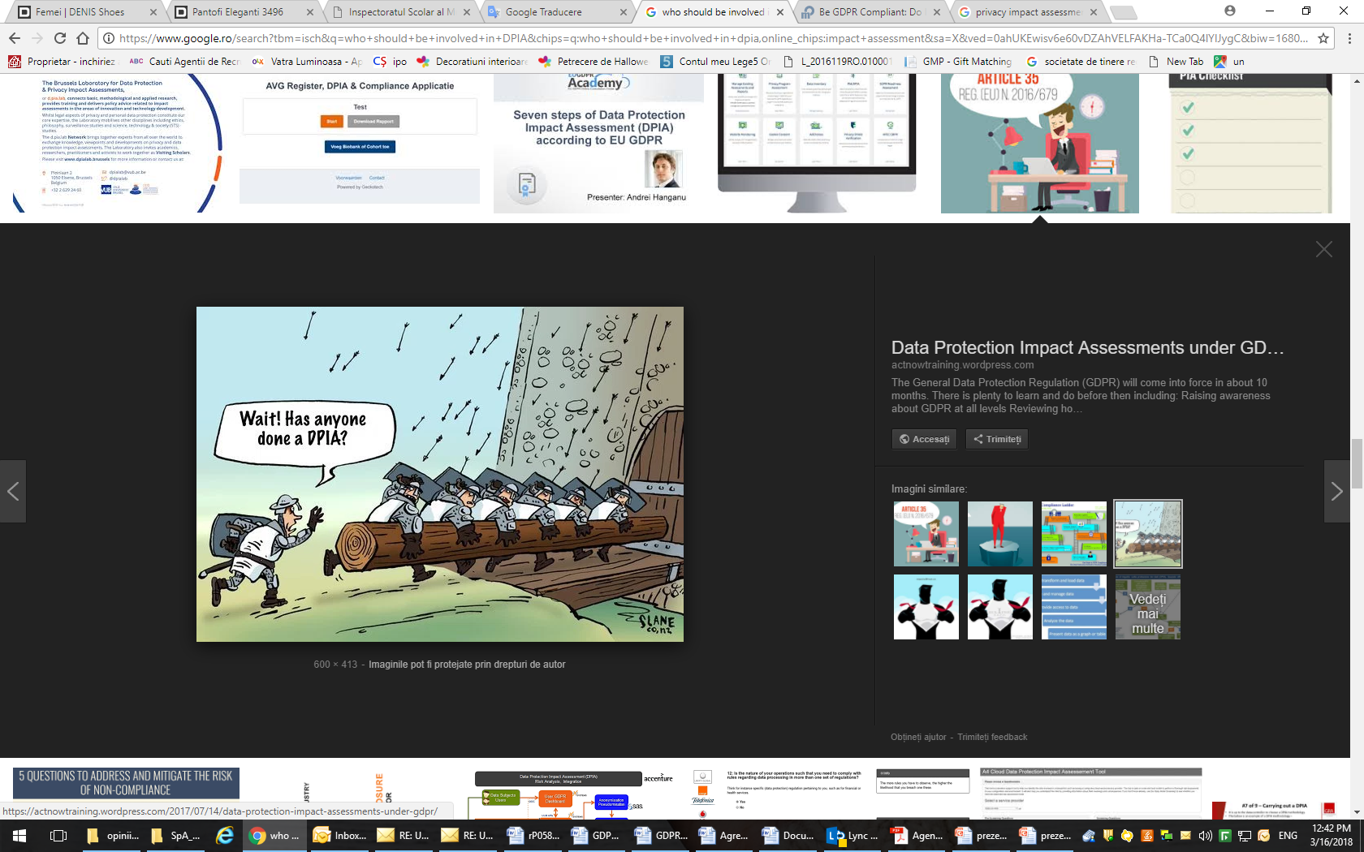

Slide 10
Thank you!

