Slide 1
GDPR - New Data Protection Regulation
From questions to answers
Delia Străchinescu, Legal Division
UniCredit Bank S.A. Public information
Bucharest, 21st of March 2018

Slide 2
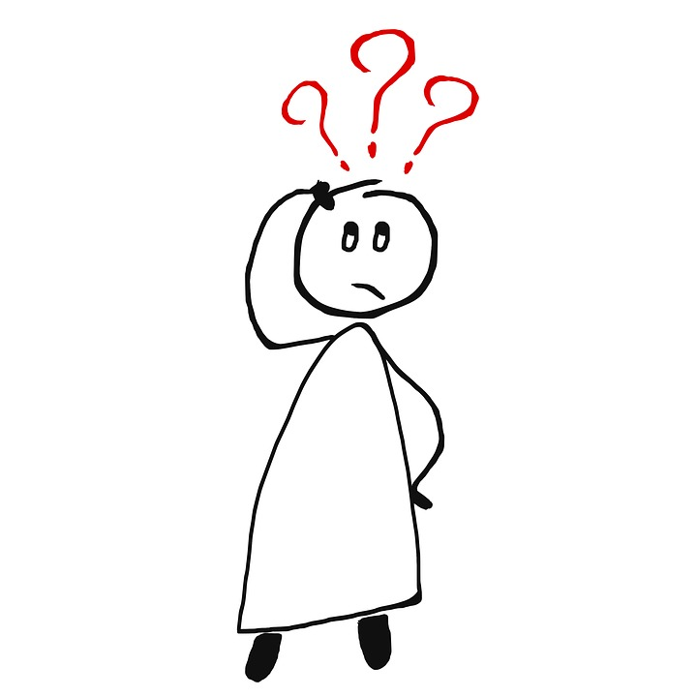
Do our company’s employees know exactly what the new privacy rules mean and what is their impact on the internal processes?

Slide 3
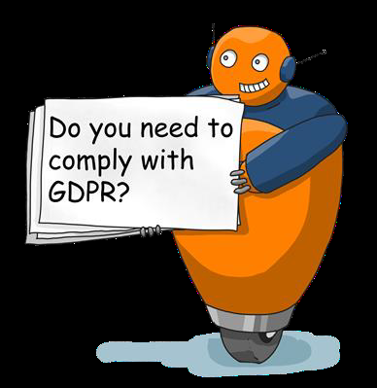
Why do we have to comply with the rules on personal data protection?
Employees of the Controller involved in data processing should be aware of the importance of complying with data protection rules whenever they process personal data irrespective of the way they are doing it.
The importance resides in:
the general interest protected by the Regulation, namely, to ensure the protection of the fundamental rights and freedoms of individuals with regard to the processing of their personal data;
severe sanctioning regime applicable to non-compliance with the requirements of the Regulation.
The maximum limit of the fine is up to EUR 20 million or 4% of the annual global turnover for breaching the obligations.

Slide 4
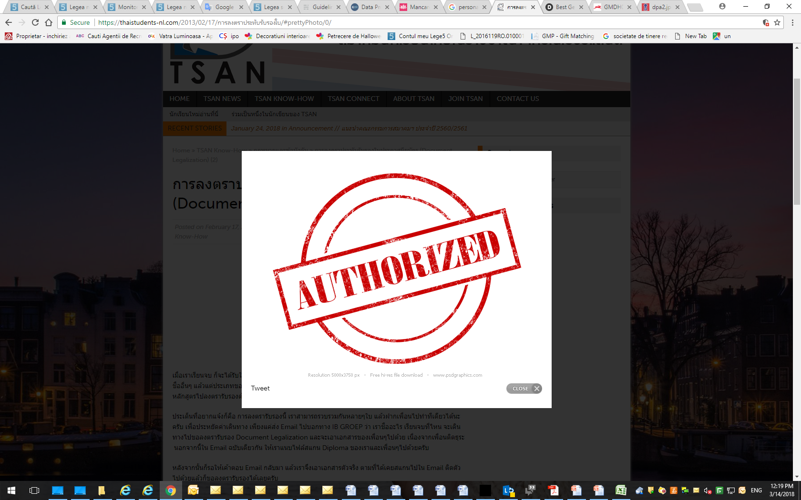
Am I authorized to access and process the data I operate?
The answer should be found, first of all, in the internal procedures or
other written materials made available to employees, elaborated by
the employer following a thorough analysis in order to re-identify
the structures and employees whose duties involve processing of
personal data on different categories of targeted persons
(e.g.: clients, suppliers, employees, etc.).

Slide 5
Steps to be followed
After reviewing the activity of the organizational structures and regulating within the internal procedures:
the categories of personal data that their employees can process and
the way in which the processing is carried out
...for each category of employees it should be established and organized :
adapted training programs for data processing;
granting different access rights to personal data (for example, only a limited category of people will have access to information on employee earnings);
evidence of people who have processed certain personal data;
technical checks and periodic tests to ensure compliance.

Slide 6

Under what conditions can other people have access to personal data collected by us?
For the empowered persons, companies have the obligation:
to conclude with them a written agreement,
to keep an evidence of these empowered persons
to make an assessment of the empowered persons regarding the guarantees they offer from the GDPR perspective, especially with regard to the specialized knowledge, the reliability of the processes and systems, the resources.
As regards ongoing agreements with such suppliers and/or empowered persons, for the purpose of ensuring compliance with GDPR’s principles and requirements, starting with 25th of May 2018 it is necessary for the data operators to undergo a review process of these contractual commitments.

Slide 7

Is it really necessary to collect all the data?
Could the purpose for which the data is collected be attained by using less personal or sensitive data?
In order to determine to what extent is necessary to collect all the data, it is necessary:
to review under the guidance of the Data Protection Officer all the documents through which the personal data are collected and
to analyze whether, for each type of data, the operator has a legal obligation or a legitimate interest to process that information.

Slide 8
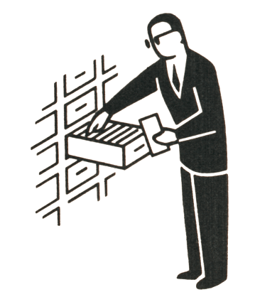
How long can I keep the personal data?
Personal data must not be stored longer than necessary to achieve the purpose for which they were collected, unless there is a legal obligation or legitimate interest on the part of the data operator.
To the extent that it is assessed that the data could be used later, and for other purposes, the consent of the data subject may be required to process the data for the new purpose brought to his / her knowledge.

Slide 9
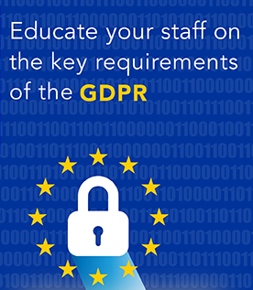
Continuous education
The subject's complexity and the multiple implications of how we handle personal data will require a continuous interpretation of the Regulation’s provisions and a constant learning and adaptation process.

Slide 10
Thank you!

